Slide 1
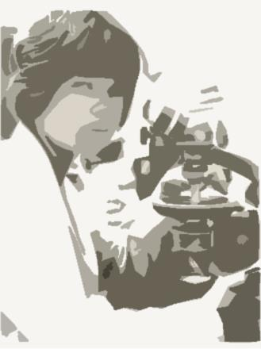
A Woman…
A Private Forensic Science Laboratory…
A Journey

Slide 2

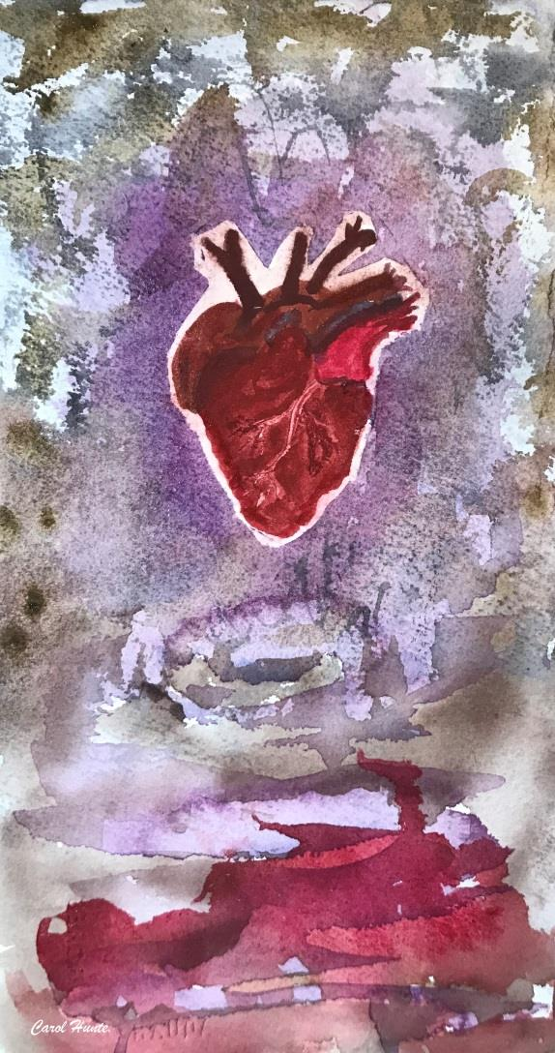
Is Your Heart
All In For This
Career?

Slide 3
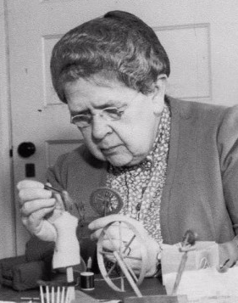
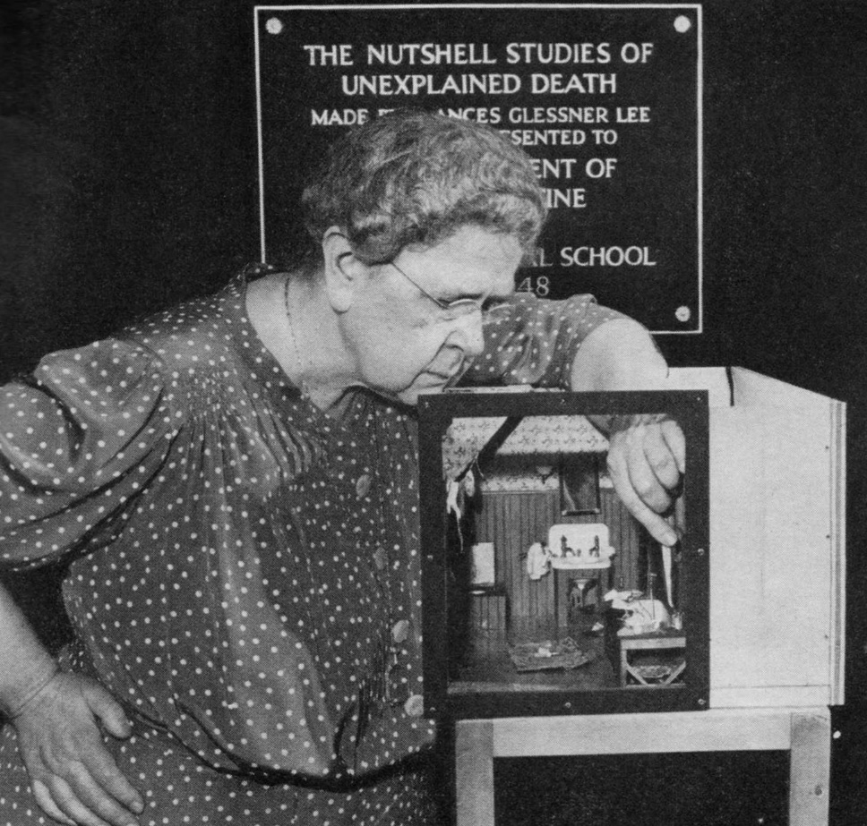
Frances Glessner Lee 1878-1962
Godmother of Forensic Science

Slide 4
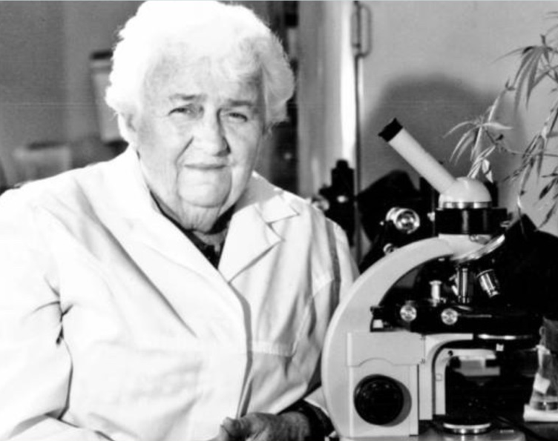
Mary Louisa Willard, “Lady Sherlock”
1898-1993
An early GENERALIST
Chemistry degree: Penn State in early 1920’s
PhD from Cornell: 1927
Professor at Cornell: 1938-1964
Wrote over 40 articles on Chemistry and Criminology plus a handbook for the Chamot & Mason Chemical Microscopy Handbooks

Slide 5
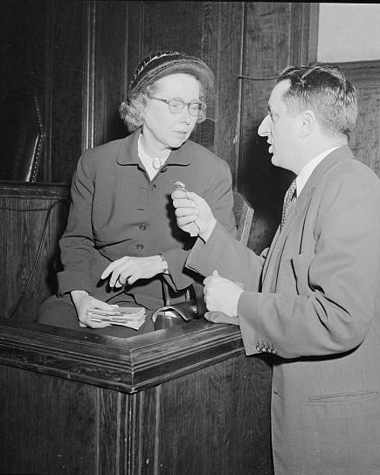
Mary E. Cowan 1907-1998
Cuyahoga County Coroner’s Office, Trace Evidence Section Supervisor, 1939-1995
AAFS Established the Mary E. Cowan Outstanding Service Award in the Criminalistics Section
B.S. Denison University, 1929
Medical Technology degree at Mt. Sinai Hospital, 1936
Postgraduate courses in biochemistry, immunology and physical chemistry at Western Reserve University

Slide 6
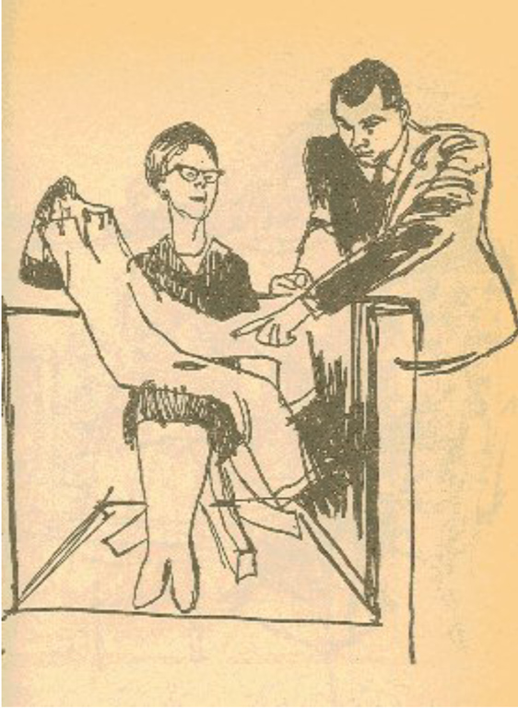
Courtroom Sketch
F. Lee Bailey &
Mary Cowan
Sam Shephard Case

Slide 7
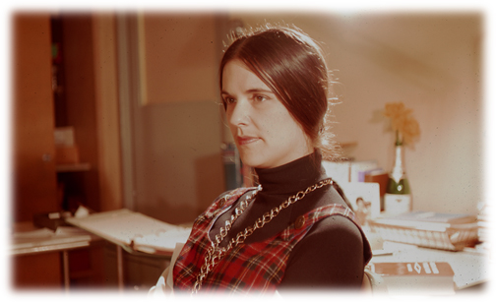
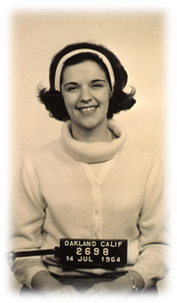
Jan Bashinski 1942-2004
1964 – Began at OPD
1977 – Became First Female Lab Director in California at OPD
1977 - Became First female CAC President
1983 – OPD the First crime lab in CA and 4th in nation to obtain ASCLD/Lab Accreditation
1989 – Became lab director of new DOJ DNA laboratory
1995 – Became DOJ Bureau Chief of Forensic Services
2002 - Retired

Slide 8

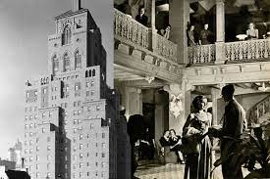


NYC

Slide 9
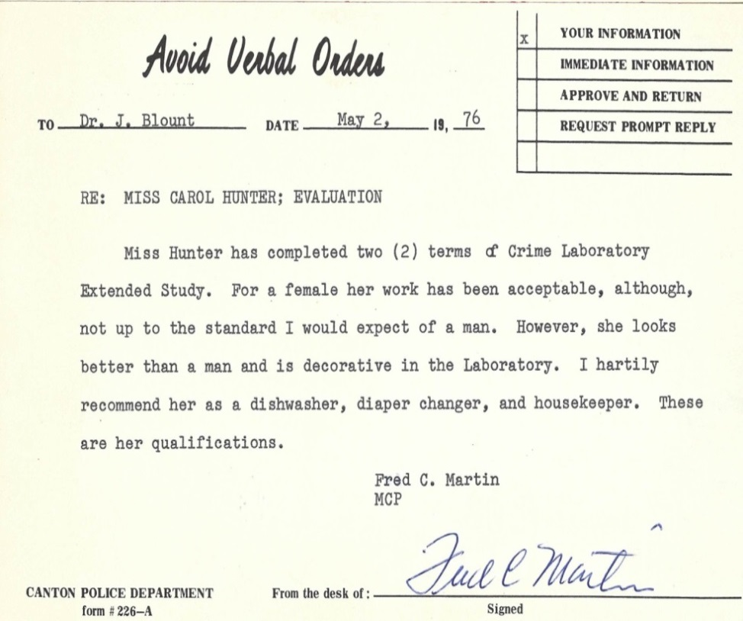
Internship
Evaluation #1

Slide 10
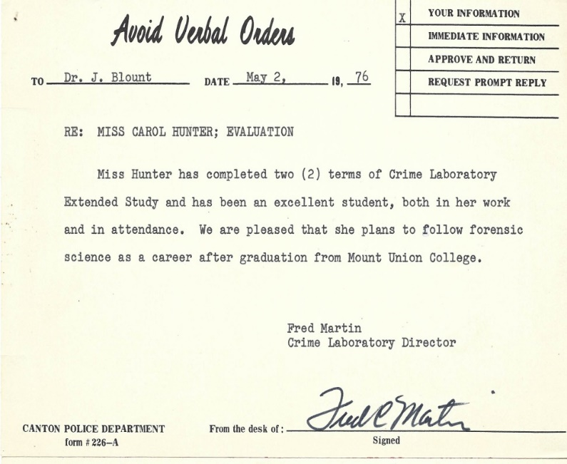
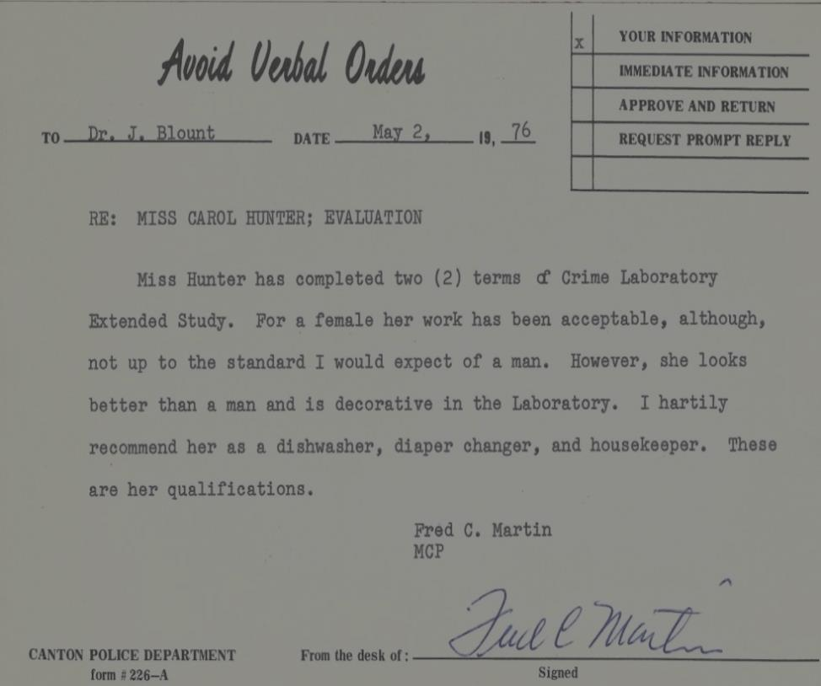
Internship
Evaluation #2
Evaluation #1

Slide 11
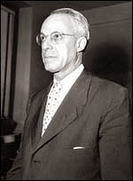
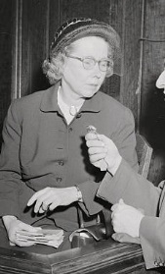
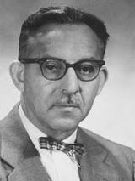
Cuyahoga County Coroner’s Office
Mary E. Cowan
Samuel Gerber
Lester Adelson

Slide 12
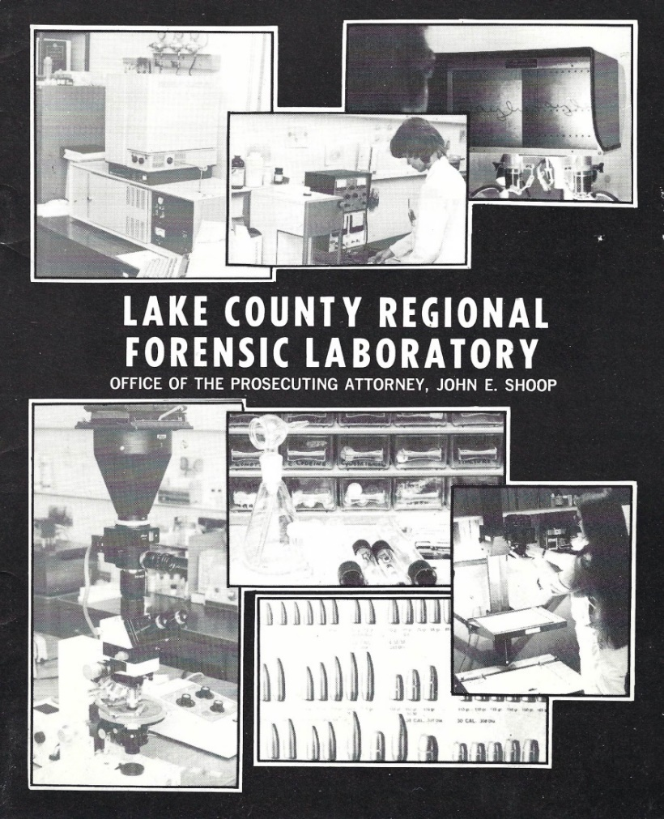

Slide 13
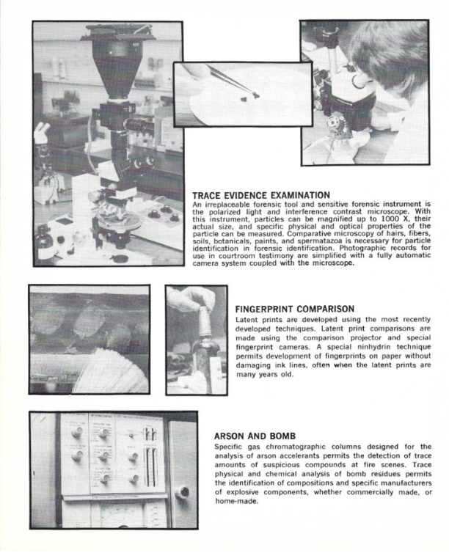
Late 70’s Technology

Slide 14
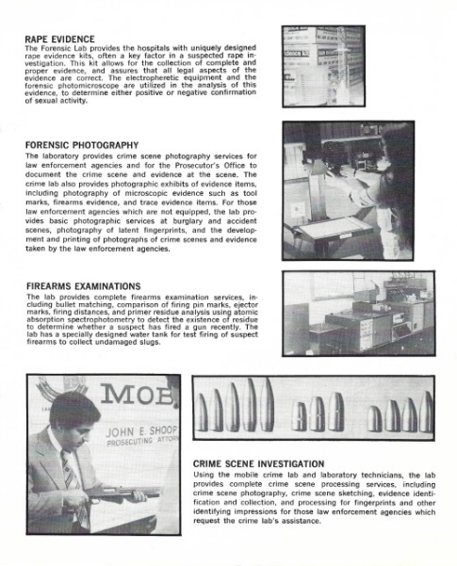
Late 70’s Technology

Slide 15
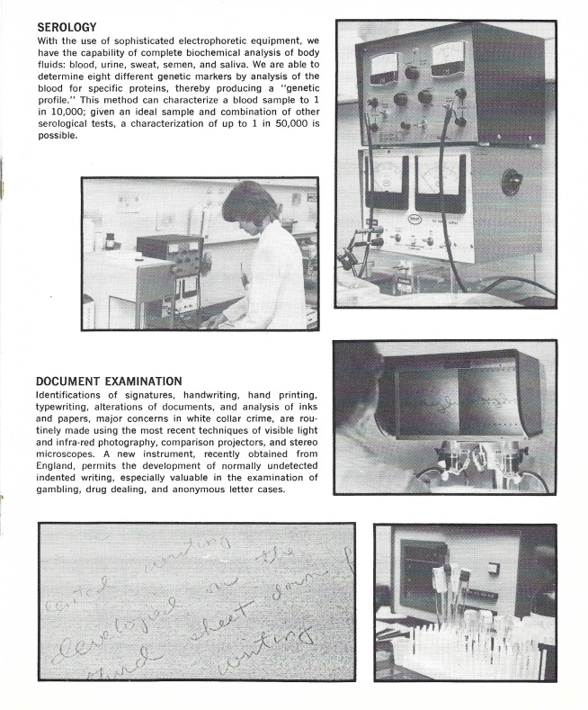
Late 70’s Technology

Slide 16
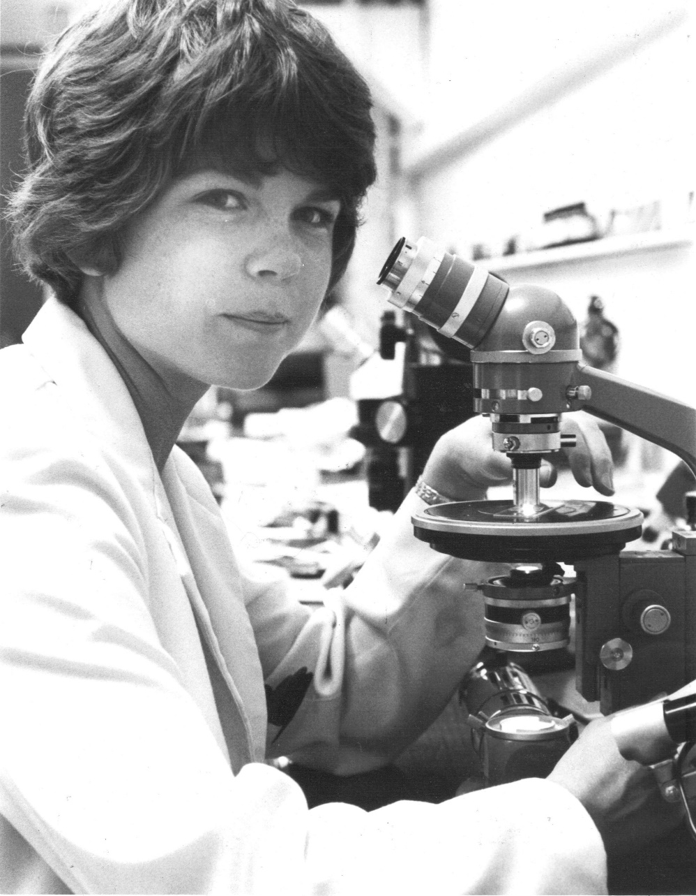
CLH on
Monocular
Olympus
Polarized Light Microscope

Slide 17
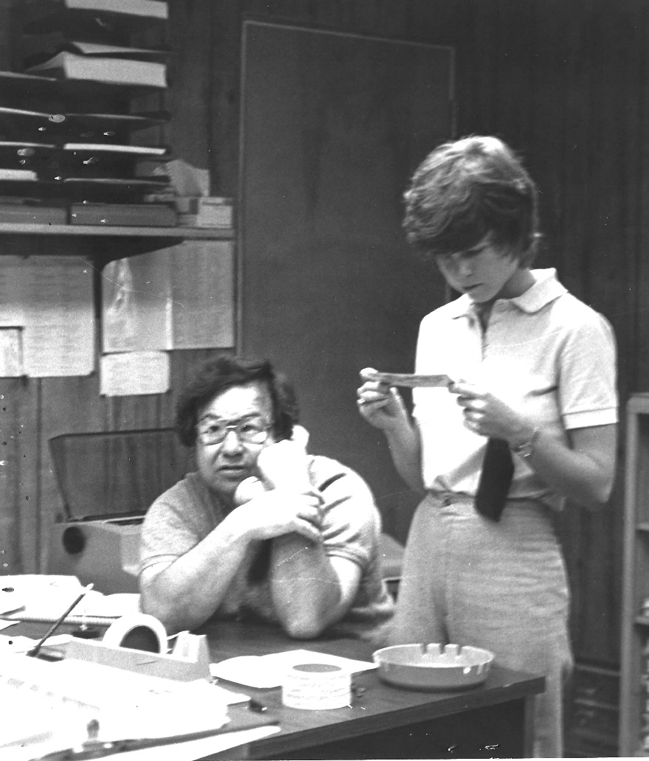
Regional Forensic Laboratory
Typical Day with Phil Bouffard

Slide 18
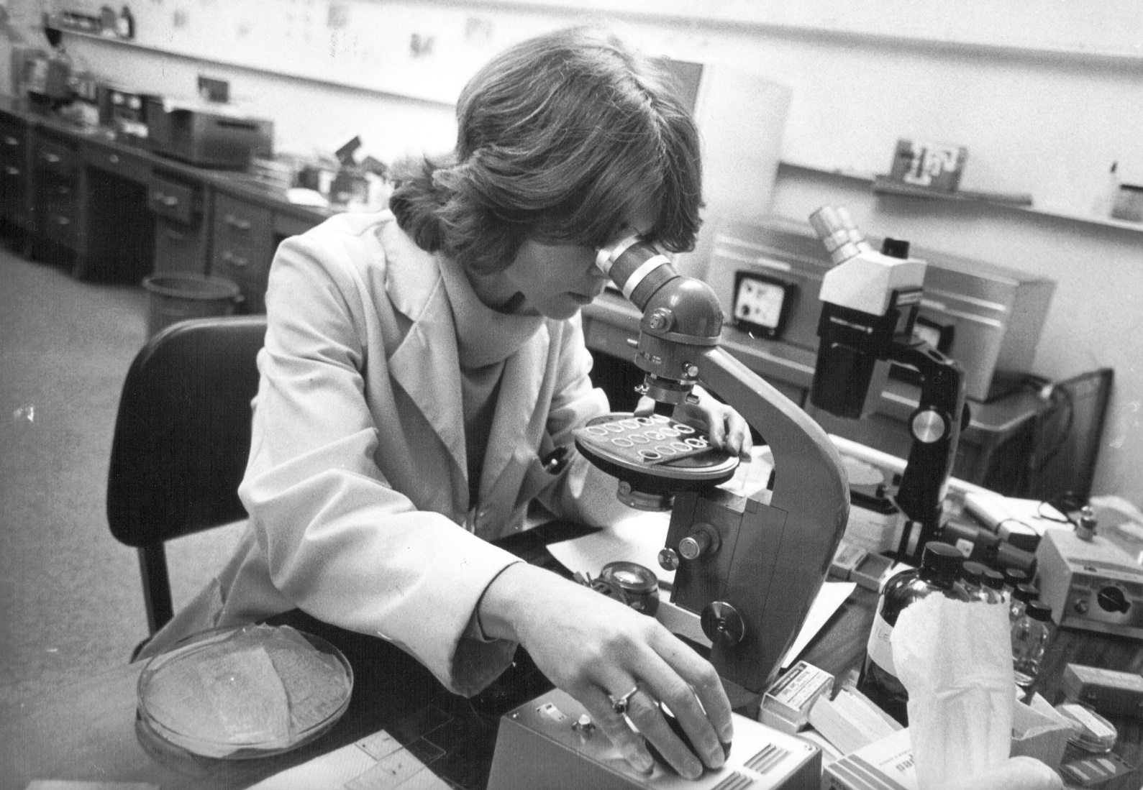
Reading ABO Elutions

Slide 19
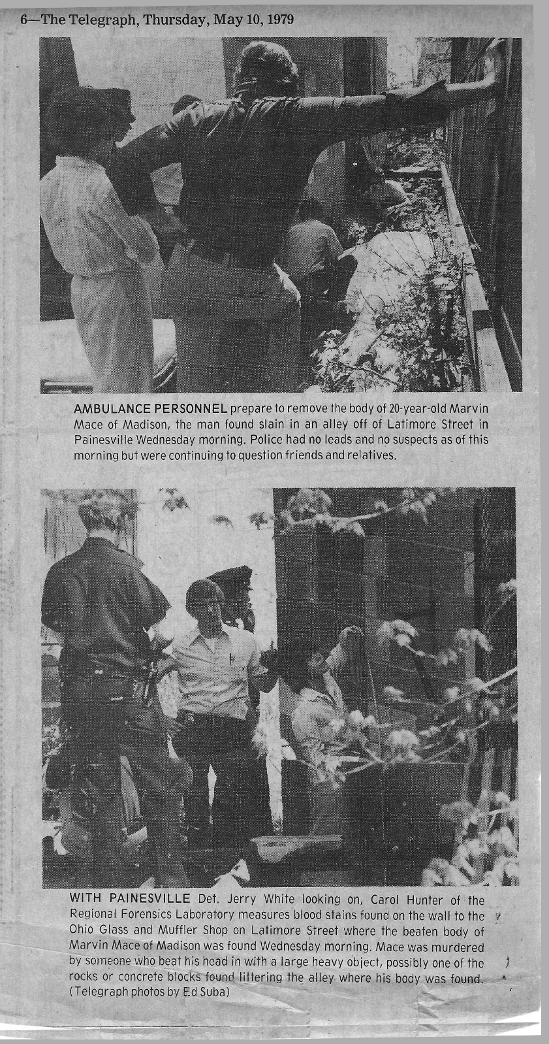
Crime Scene Processing

Slide 20
LEAA: Law Enforcement Assistance Administration of 1968
Billions in federal aid to law enforcement
Forensic Crime Labs increased from 100 to 300
NIJ funded Brian Culliford’s The Examination and Typing of Bloodstains in the Crime Laboratory, 1971
Forensic Science Foundation grants funded Forensic Microscopy Workshops and the Electrophoresis Multisystem

Slide 21
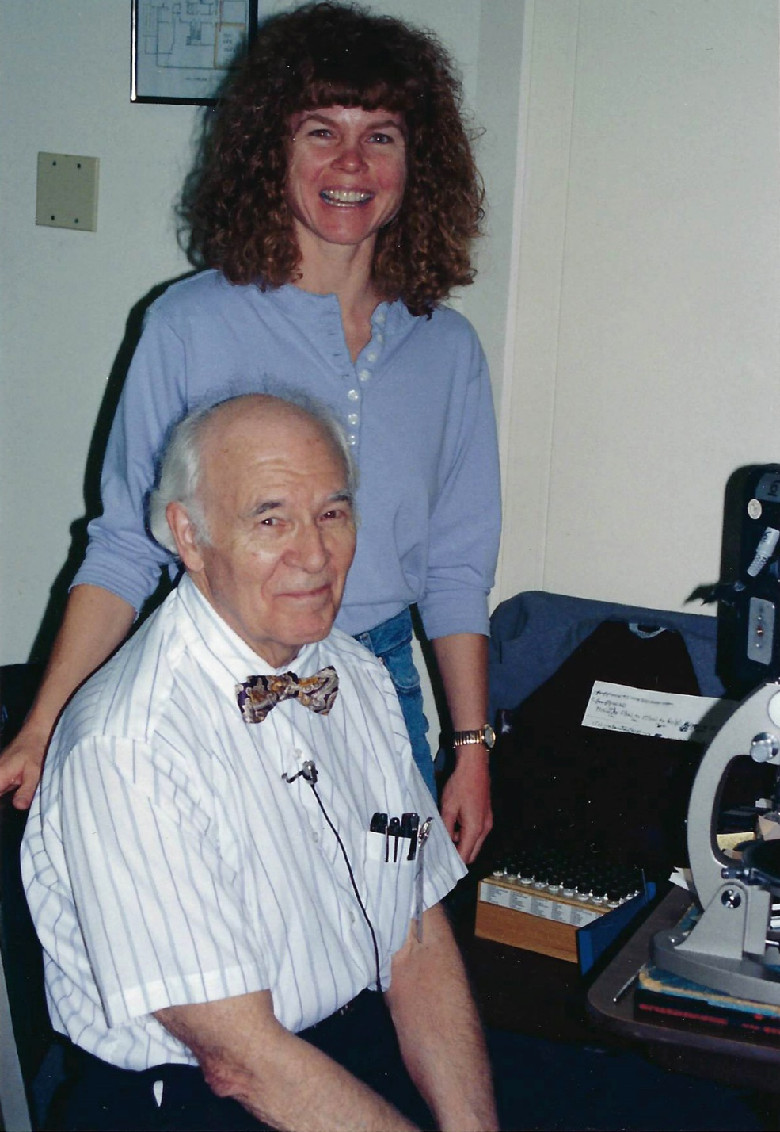
Dr. Walter McCrone

Slide 22
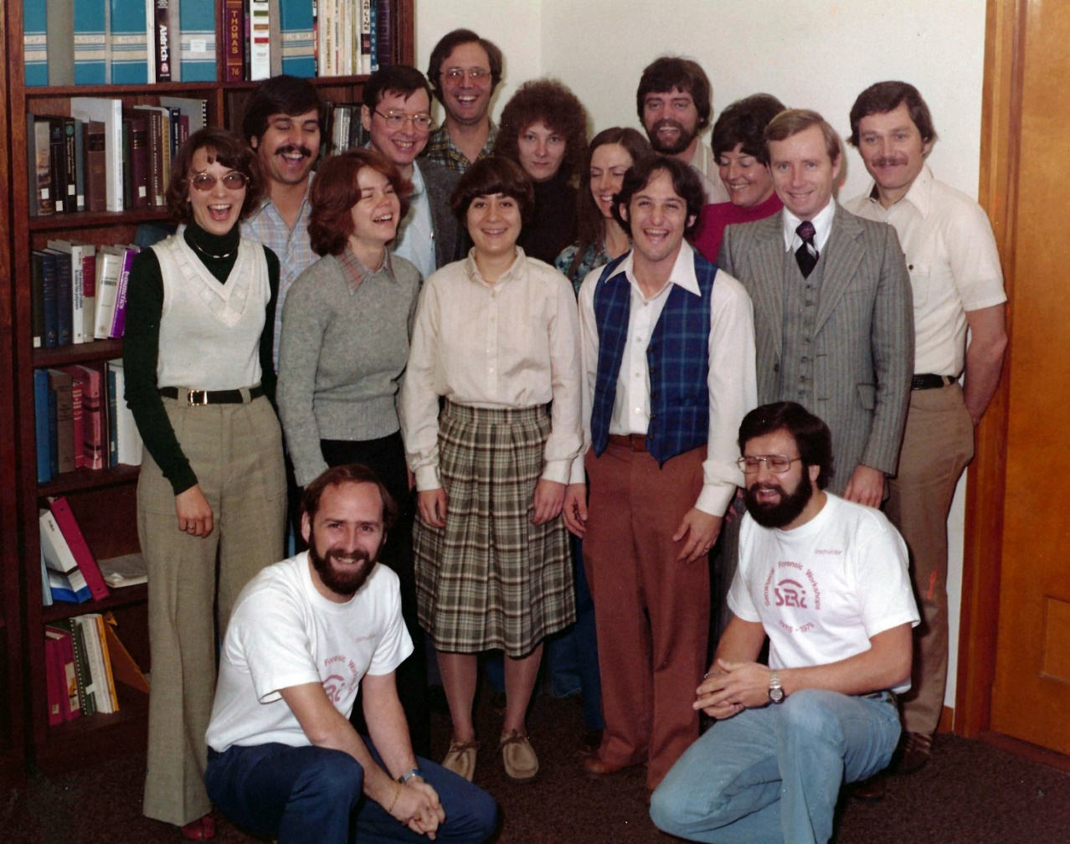
SERI Multisystem Class 1979
A few familiar faces

Slide 23
Private Forensic Science Laboratory Practice
Set up the Southern IFS lab physical space, equipment & supplies, etc.
Develop client relationships
Consult with clients in criminal & Civil cases
Build positive relationships with colleagues
Track billable time
Notes:
Serological equipment - building the multisystem electrophoresis tanks from provided plans instead of purchasing them from SERI
Microscopy equipment - Only a stereo microscope for the trace evidence work was supplied. I supplied an AO biological however I could do no polarized light particle/fiber analysis.

Slide 24
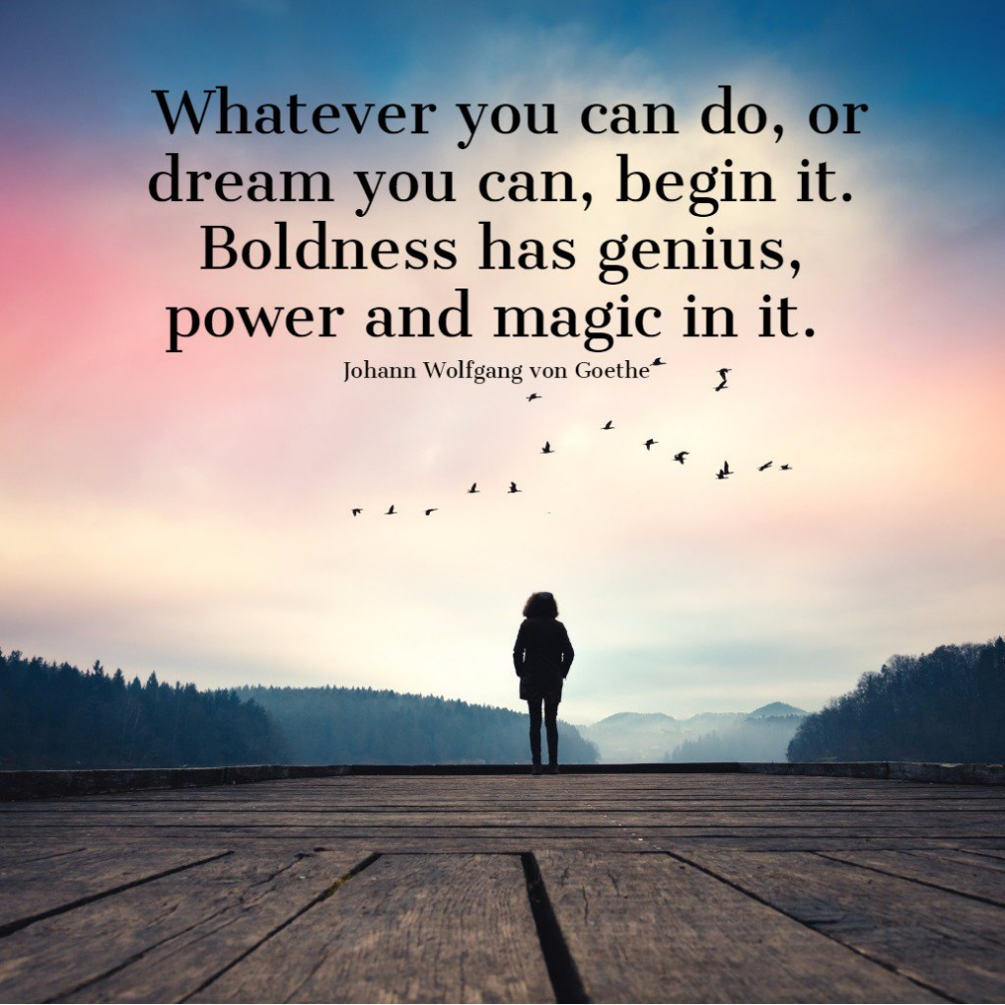
Cal Lab Beginnings

Slide 25
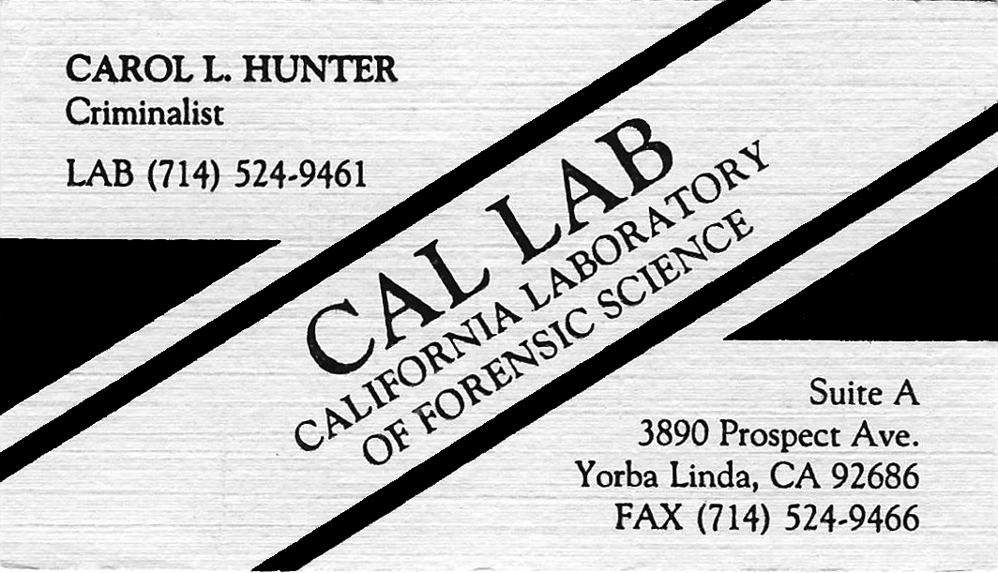

Slide 26
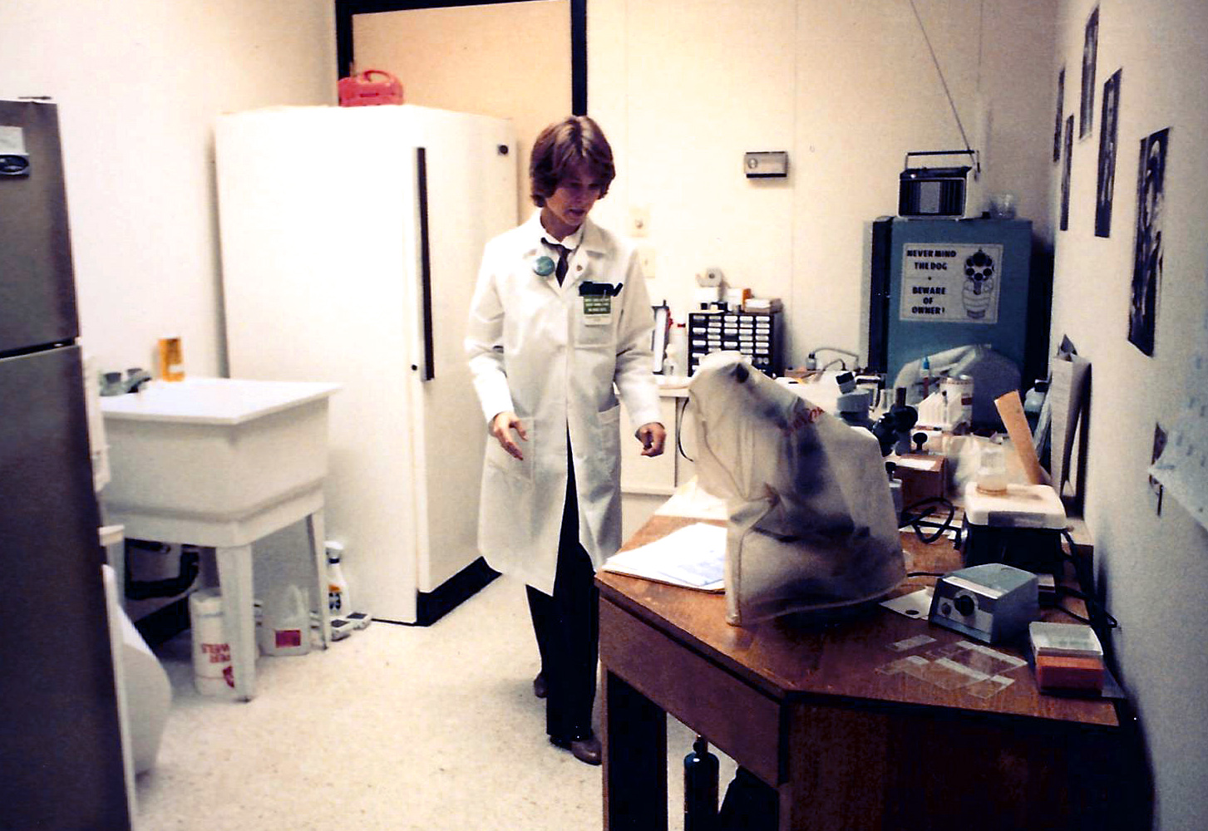
Cal Lab – Version 1.0

Slide 27
THINK ABOUT IT…
What are the costs of a forensic laboratory???
Rental space
Clerical support/salary
Office supplies
Laboratory supplies
Laboratory equipment
Telephone bills
Health Insurance
Salaries/bonuses
Training costs
Professional organization dues
Technical library/journals
Meeting expenses
Travel expenses
Bio-Hazard disposal
Outside services expenses
Advertising
$$$$ CHA-CHING $$$$

Slide 28
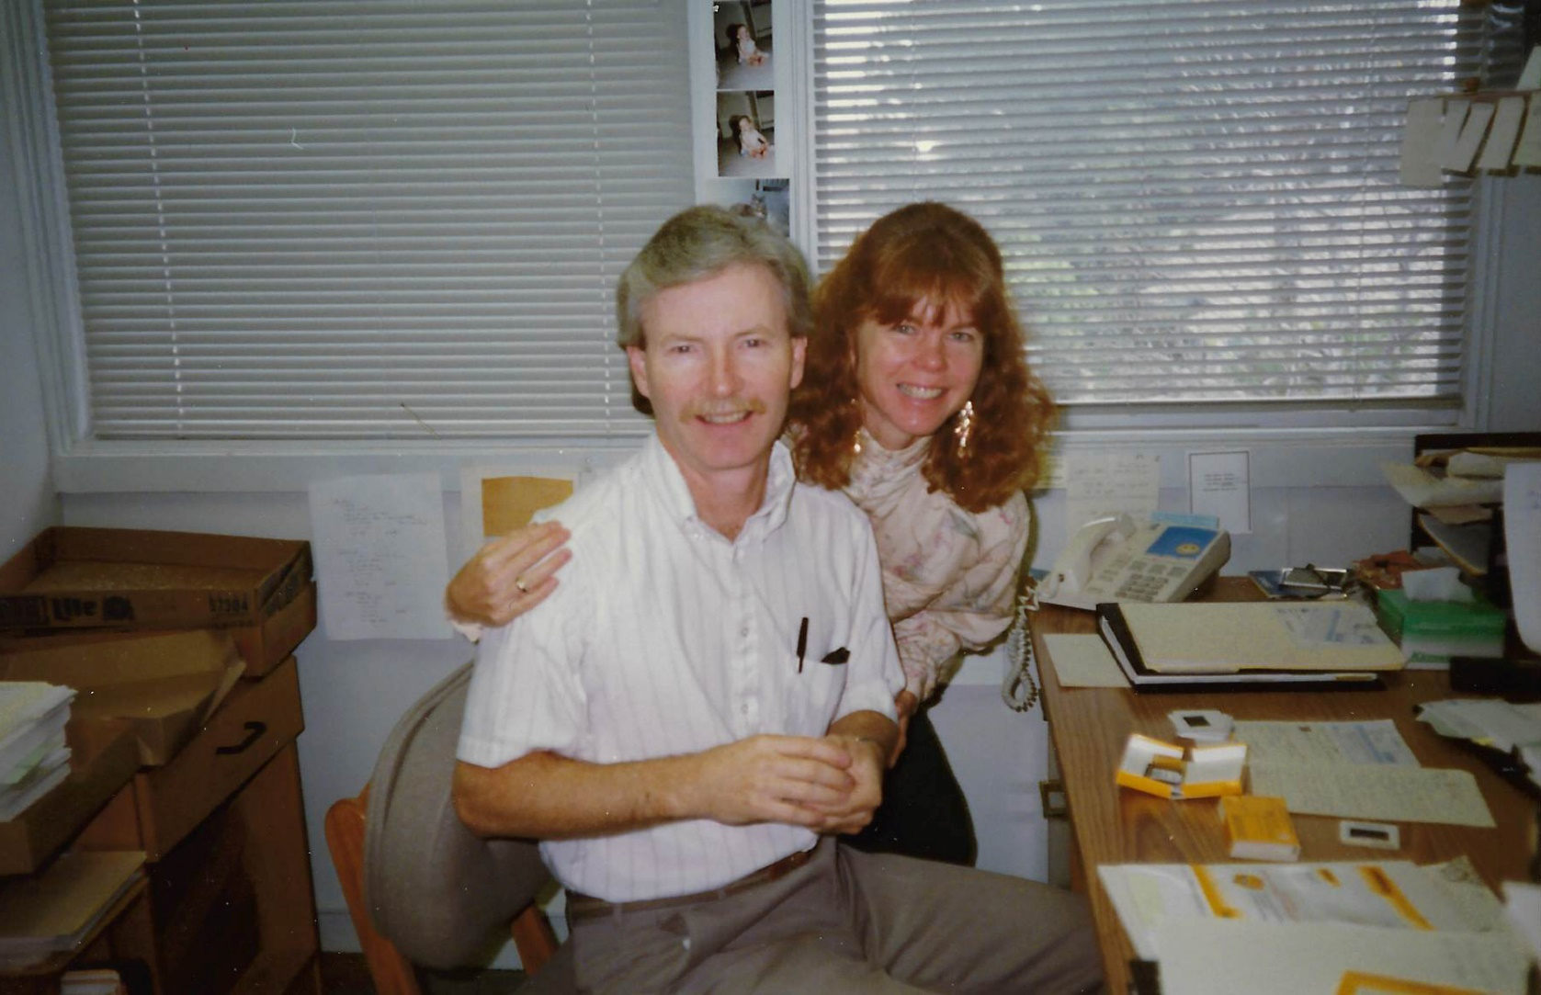
Partnership

Slide 29
Full Service
Forensic Science Laboratory
Arson
Blood Alcohol
BA/Tox Typing
Bloodstain Pattern
Combo
DNA - outsourced
Firearms - outsourced
GSR
Physiological Fluids
Sexual Assault
Scene Reconstruction
Shoe/Tire Impressions
Toxicology - outsourced
Trace Evidence
Courier Services - outsourced

Slide 30
Clients:
Categories and States
Categories
States
Defense Attorneys and Public Defenders
Prosecutors
Civil Attorneys
Private Investigators
Insurance Companies
Private individuals
California
Oregon
Washington
Arizona
Missouri
Minnesota

Slide 31
Annual Caseload
Year
# Cases
Analyst
1983
1984
1985
1986-1990
1991-1994
1995
1996
47
103
138
300+
327
186
58
CLH
CL
CLH/SAS
CLH/SAS
CLH/SAS/DMG
CLH/DMG
CLH/DMG

Slide 32
Total Case Category Percentages
BA, Tox, BA/Tox Typing
Physiological Fluids
GSR
Trace Evidence
Sexual Assault
Bloodstain Patterns, Scene Reconstruction, Combo, Shoe/Tire
Arson
35 %
15 %
13%
13%
12 %
7 %
5%

Slide 33
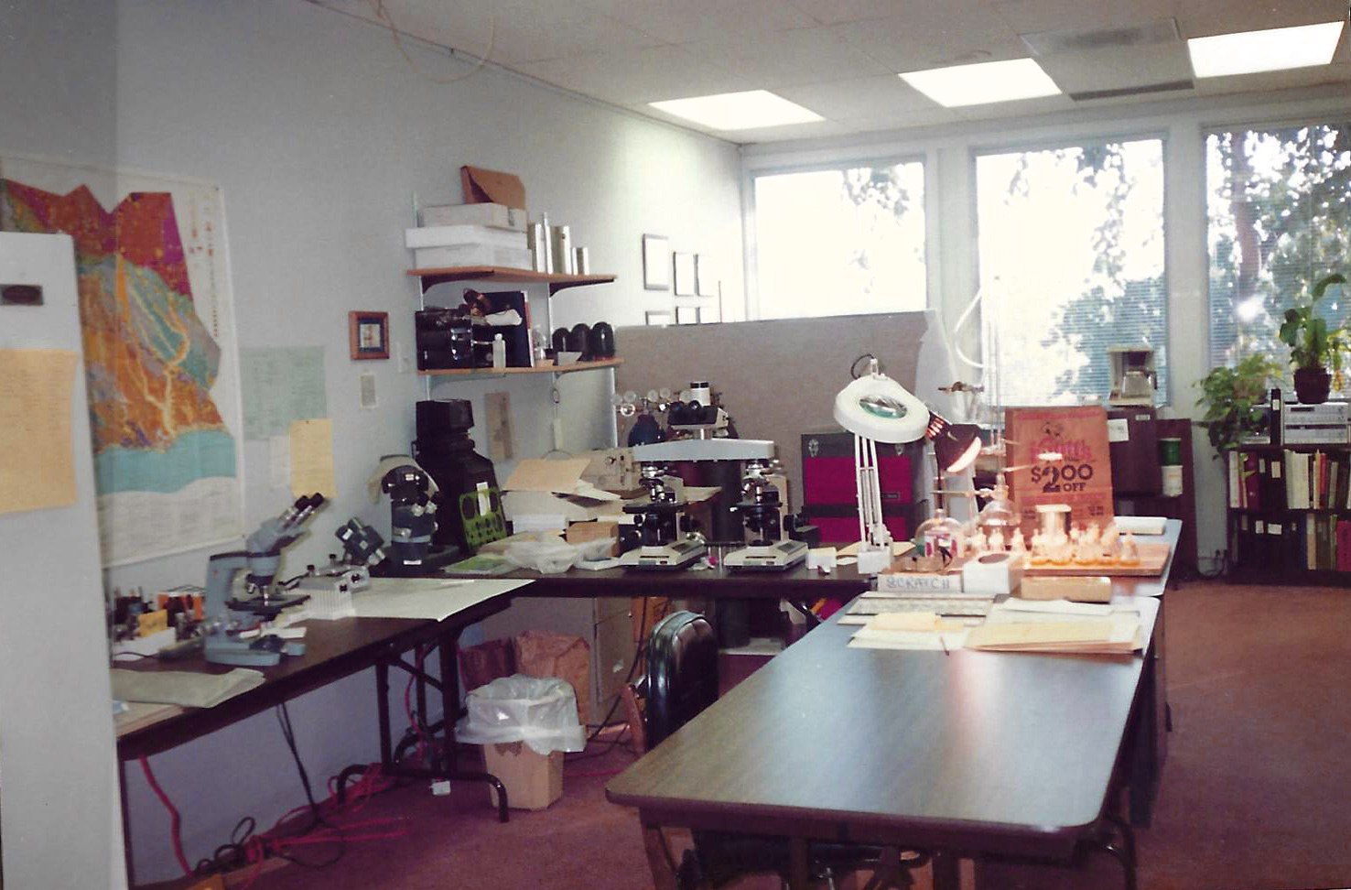
Cal Lab - Version 2.0

Slide 34
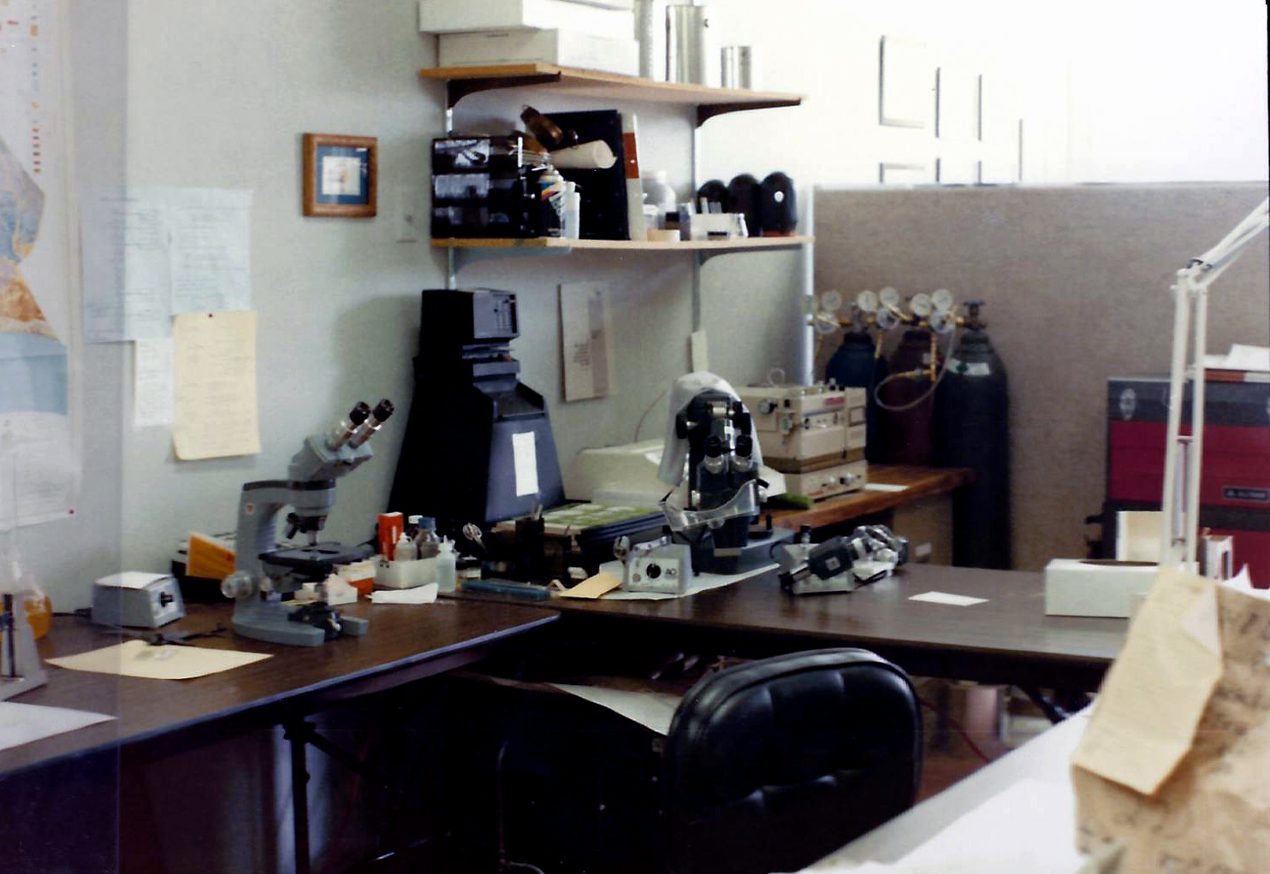
Cal Lab - Version 2.0

Slide 35
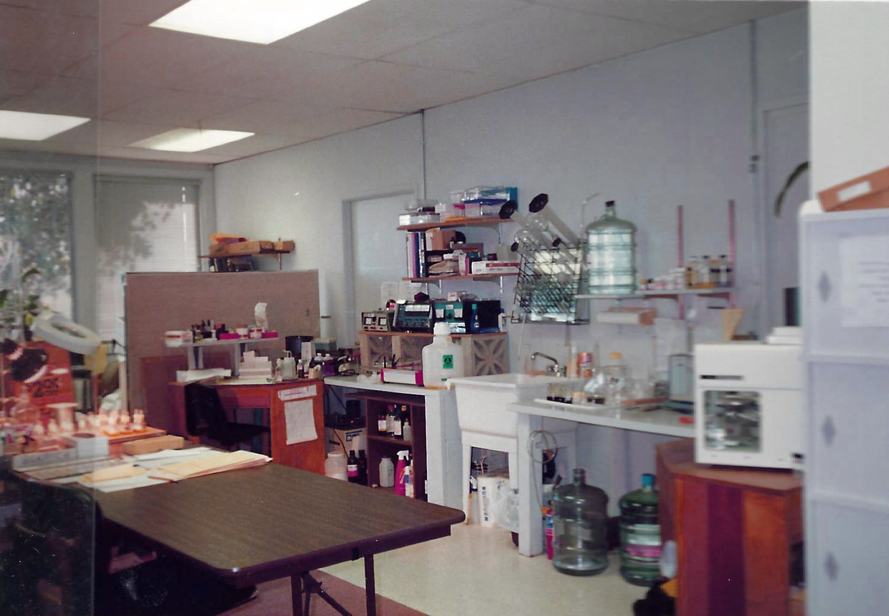
Cal Lab - Version 2.0

Slide 36
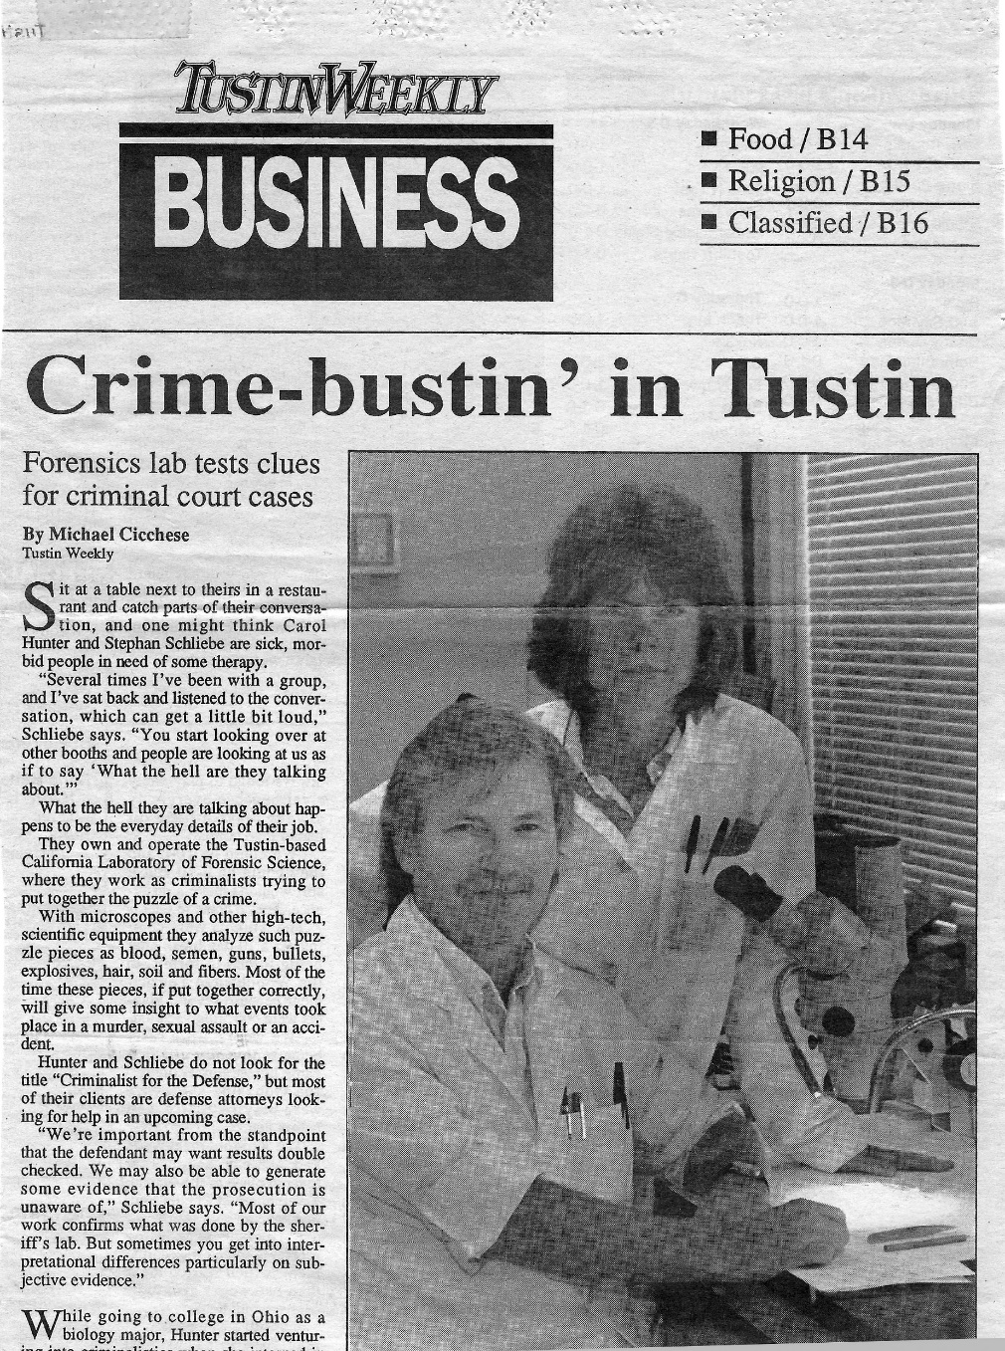
Local Publicity

Slide 37
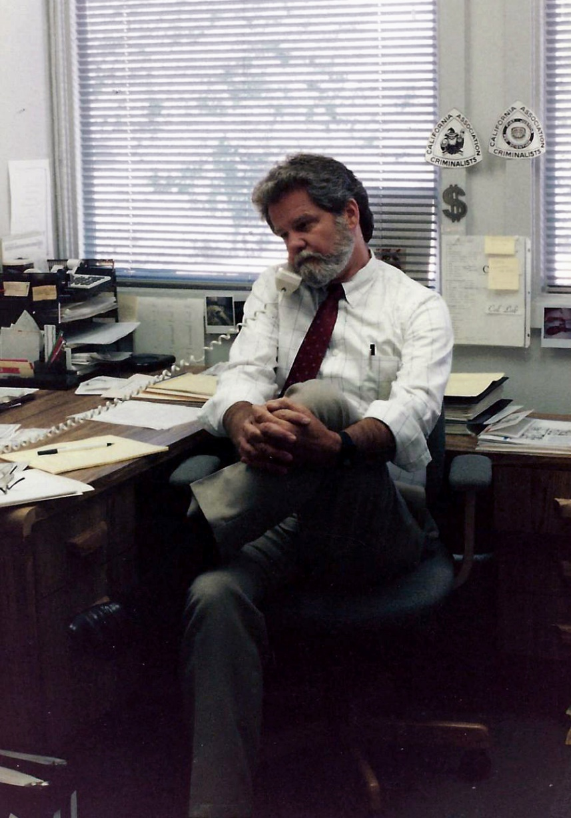
The Occasional Interloper!

Slide 38
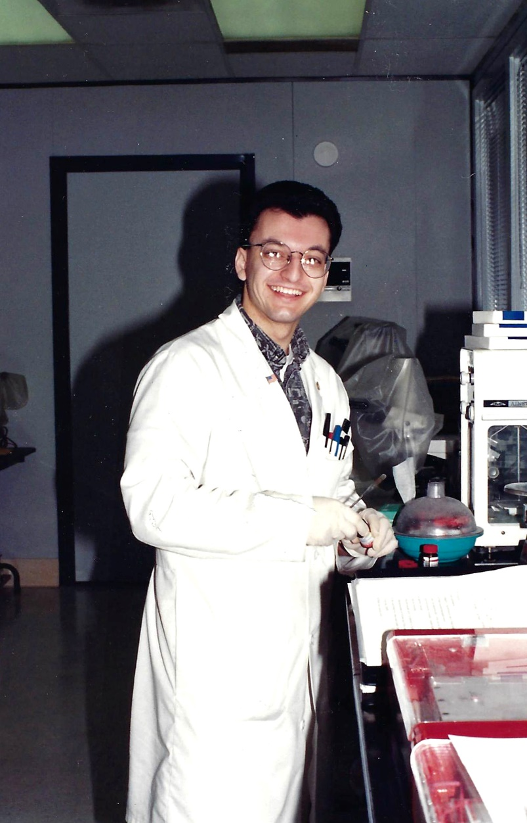
New Employee
Recognize Him?

Slide 39
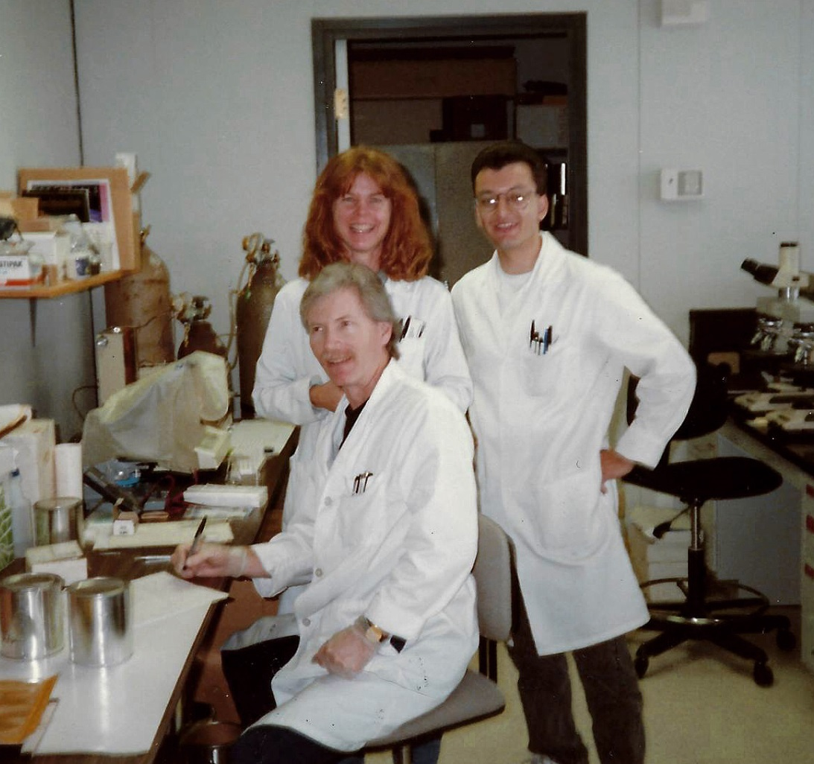
Cal Lab Team

Slide 40
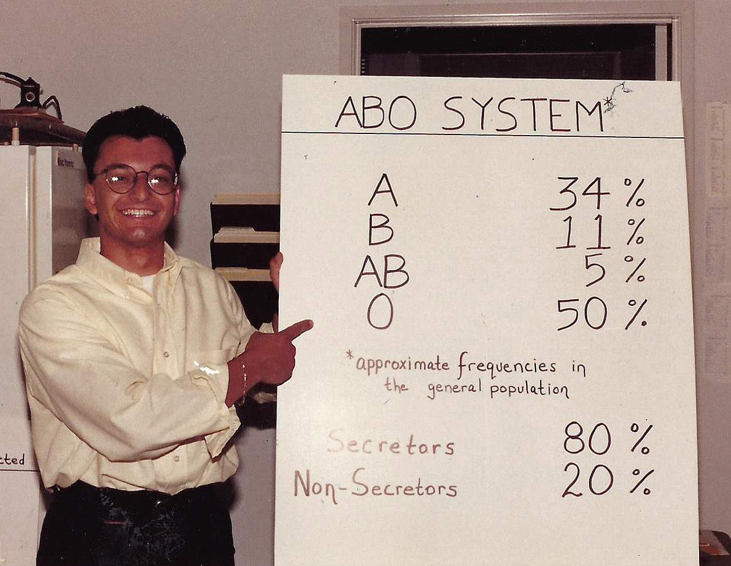
Courtroom Exhibit

Slide 41
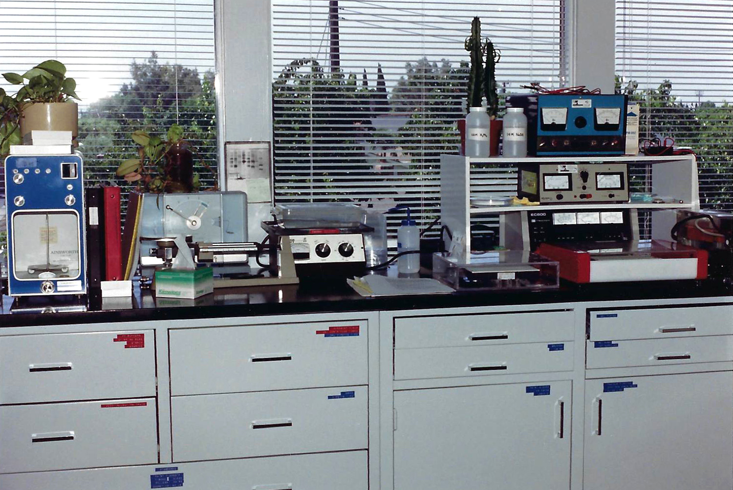
Serology Section – Version 3.0

Slide 42
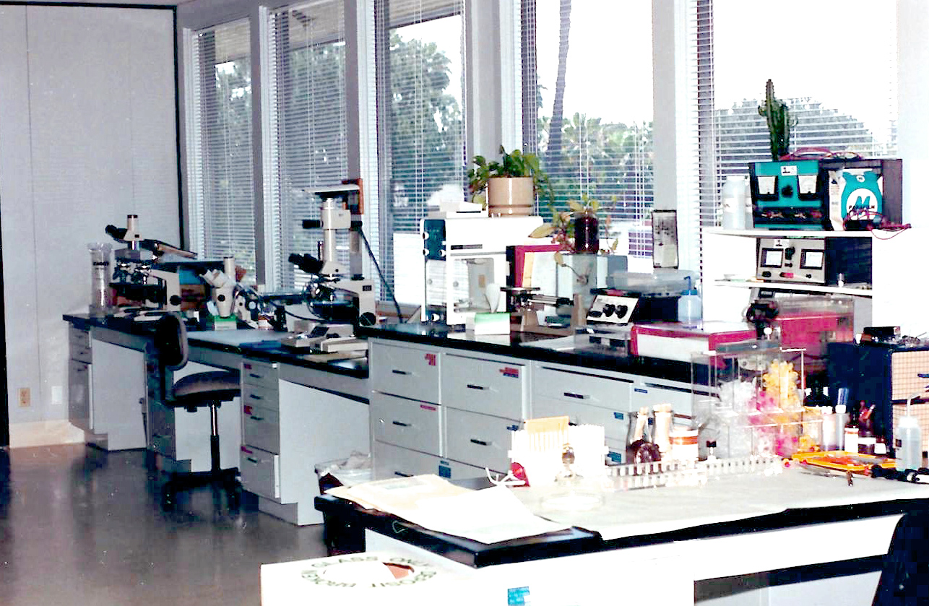
Microscopy Section – Version 3.0

Slide 43
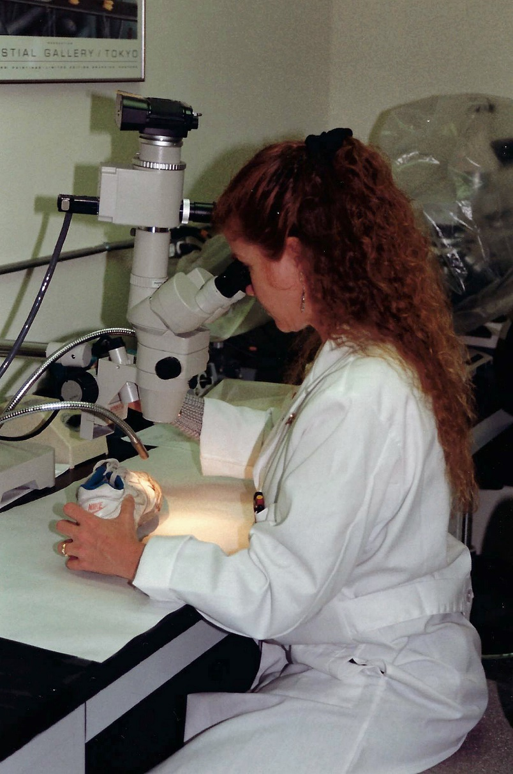
Cal Lab
Version 3.0

Slide 44
Building Collaborative Trust/
Relationships
Obtain comparable/identical training
Demonstrate competency
Participation and leadership in Forensic Science professional organizations
Casework: Discussions about case approach, methodology, conclusions, thought processes

Slide 45
Professional Involvement
CAC, MAFS, AAFS, ABC, CACLD
Committee Member: Genetic Marker Typing, Endowment, Management Practices
Committee Chair: Serology Study Group, Training and Resources, Endowment, ad hoc DNA on PCR Standards, Historical
CAC Membership Secretary, two terms
CAC President Elect, President, Past President
AAFS Representative to the ABC Exec Board

Slide 46
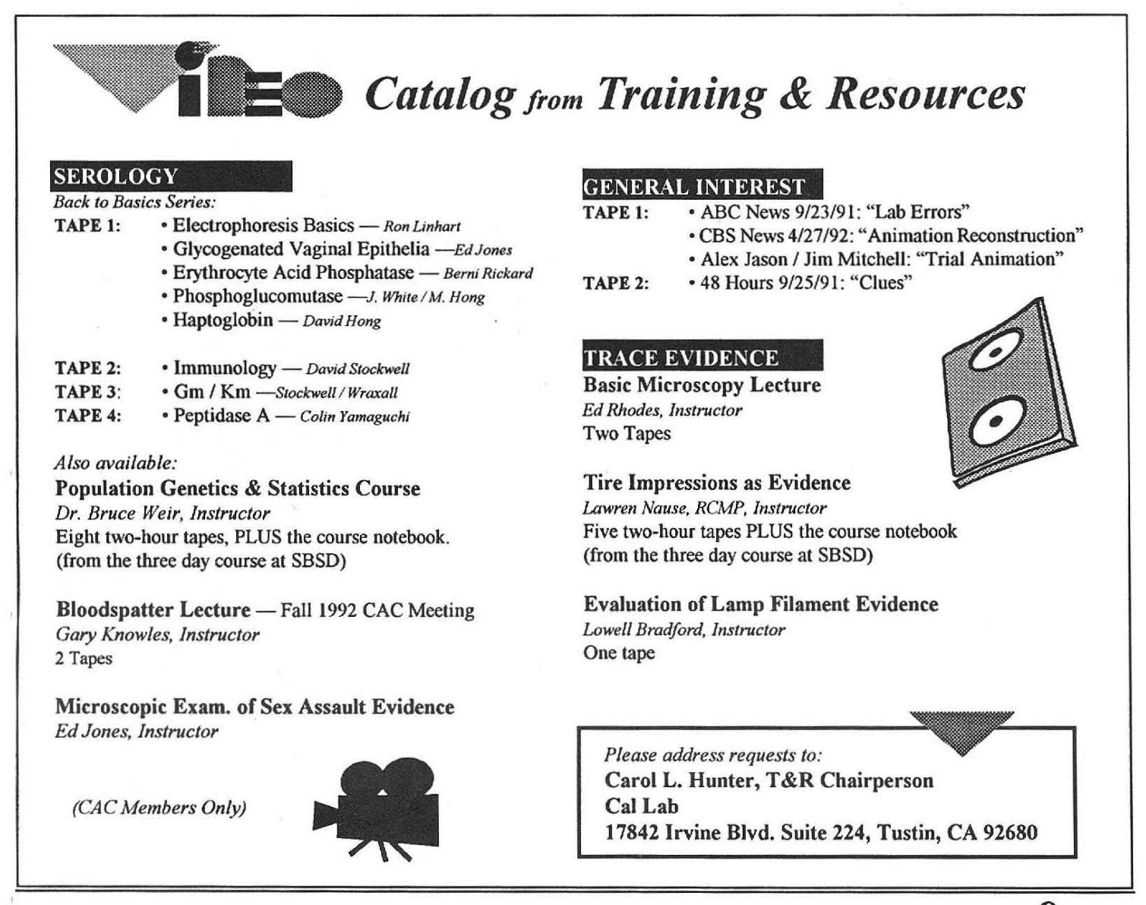

Slide 47
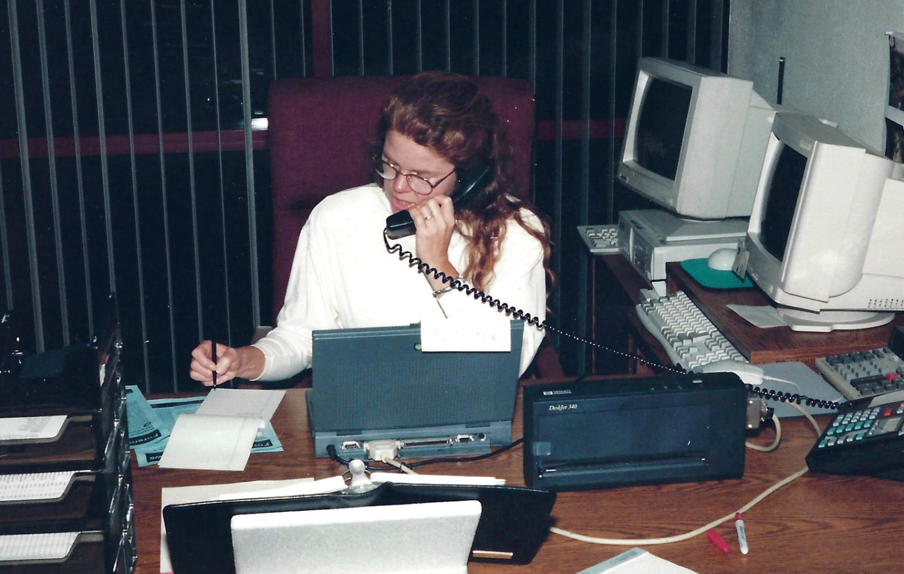
Possible New Case
Conference Call

Slide 48
Cal Lab Client Training
Cal Lab Attorney seminar on evidence
In-service training for Public Defenders
In-service training for investigators
The first arson/fire debris dog and handler training in California

Slide 49
Case Approach
Client Consultation
Ask the right questions
What is the significance of the evidence in relation to the case?
What kind of evidence do you expect?
What does it mean? Strengths? Weaknesses?
Is it unique?
What type of association?
Repeat analysis when requested or required

Slide 50
A Few Famous Cases
Marvin Pancoast, murder of Vicky Morgan, mistress to Alfred Bloomingdale
Christian Brando, murder of Dag Droilet, boyfriend to his sister Cheyenne Brando
Randy Kraft, serial killer of young men
Bill Suff, serial killer of prostitutes
Neutral Lab site for experts in OJ Simpson

Slide 51
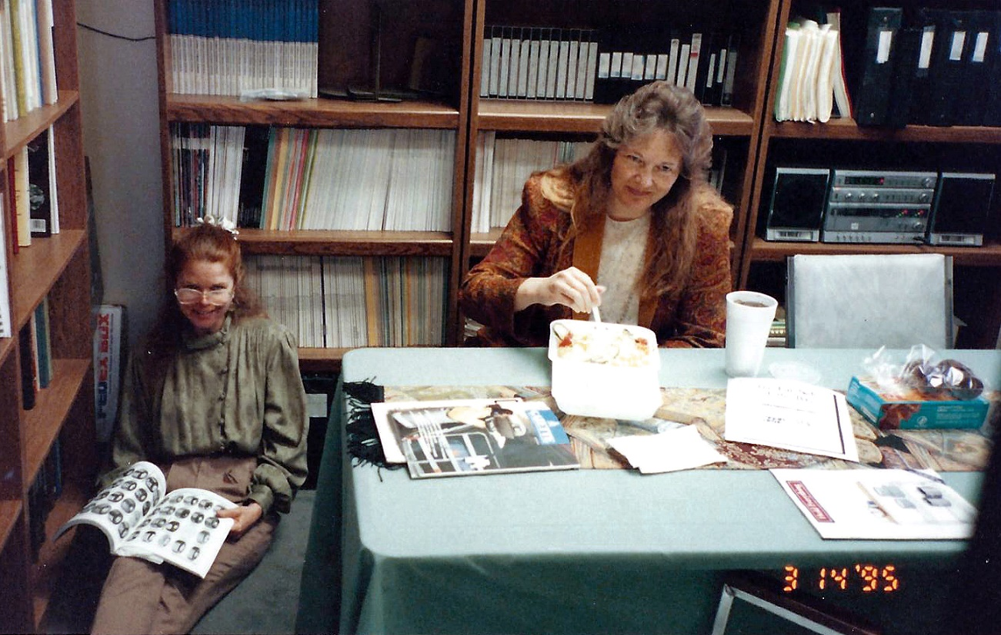
Cal Lab As A Neutral
Independent Laboratory
For Defense Experts Evidence Exams
OJ Simpson Case

Slide 52
As you listen…
Think about accreditation guidelines
  Requirements for laboratory physical space
    “Environment- Laboratory managers are obligated to provide a safe and functional work environment with adequate space to support all the work activities of the employee.”
  Avoidance of cross contamination (on a loading dock)
    “Facilities must be adequate so that evidence under the laboratory’s control is protected from contamination, tampering or theft.”
  Would you work under the conditions we were given?

Slide 53
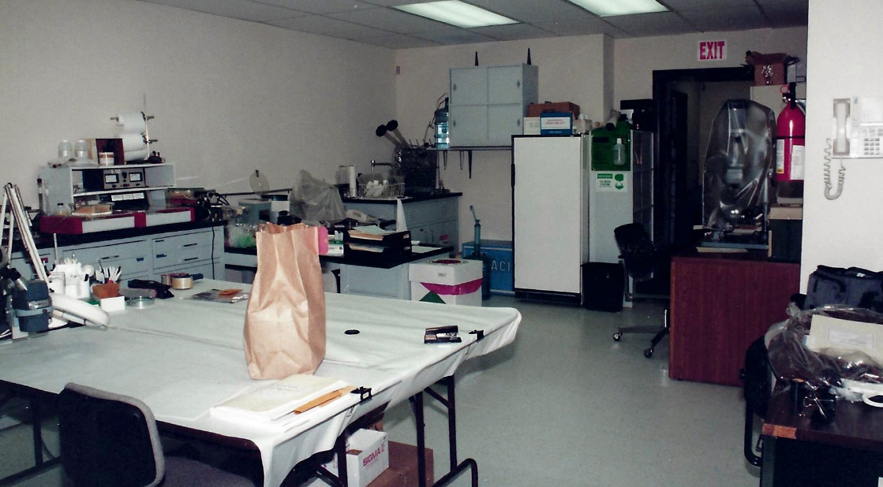
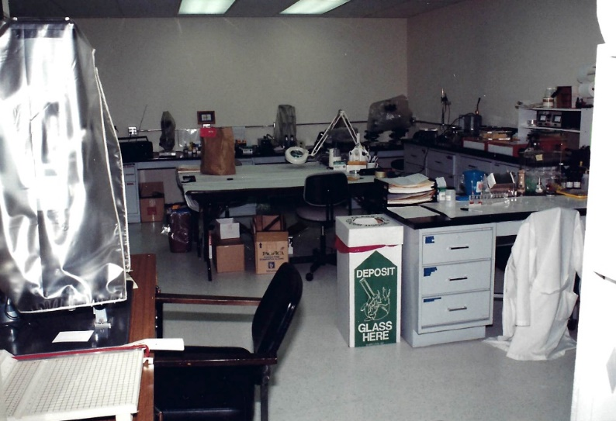
Cal Lab - Version 4.0

Slide 54
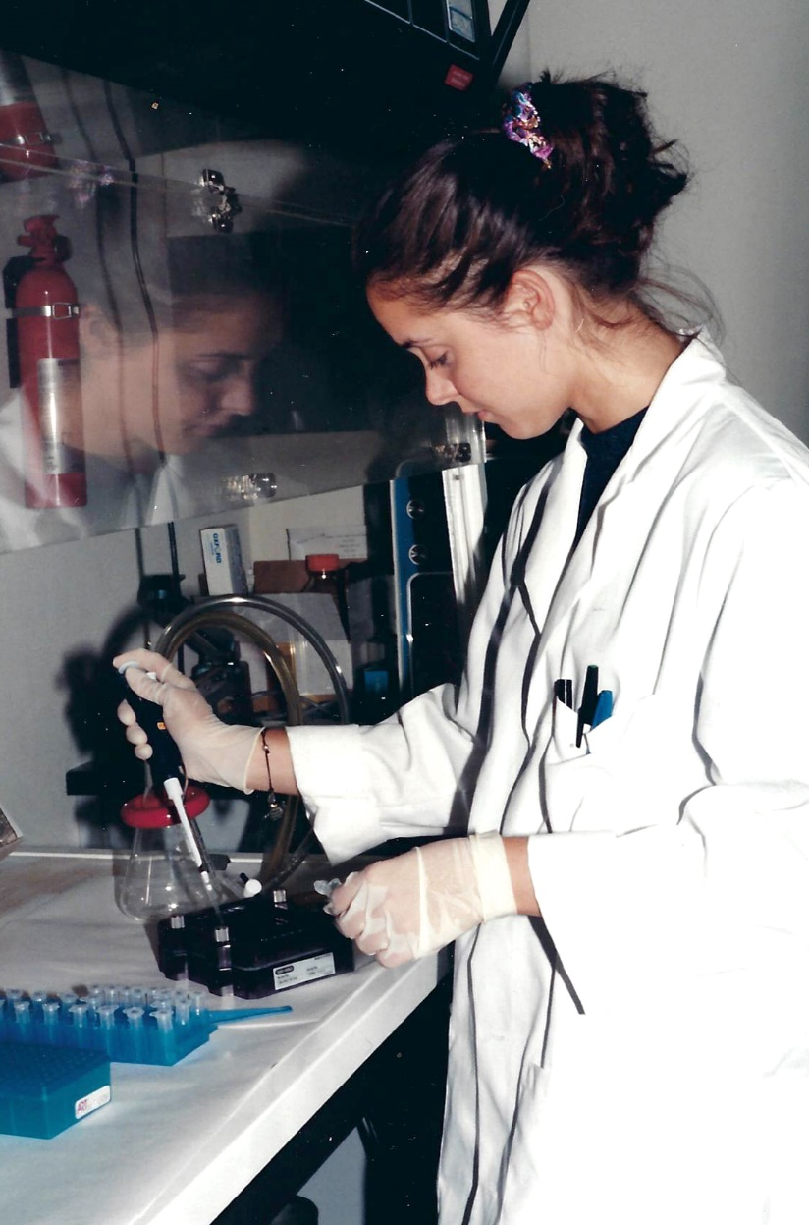
Cal Lab - Version 4.0
Getting PCR Technology Online

Slide 55
Closure of California Laboratory of Forensic Science
How to close down an existing consulting/testing laboratory?
What to do with 13 years of case files?
What to do with evidence permanently assigned?
What to do with all equipment and supplies?
How to wind down caseload?

Slide 56
The Heart of the Matter
Our role is to Represent the Evidence
  Not the police
  Not the prosecutor
  Not the defense attorney
  Not the victim
  Not the defendant

Slide 57
Professional Involvement and Commitment
If you are not involved, you should be
You don’t have to be ‘on the payroll’ while contributing to your professional organizations
Time and expense for professional training/ advancement does not solely fall of the shoulders of your employer
Your Career is your commitment. In private practice, time is money…but you must also be committed to your advancement, your profession’s advancement

Slide 58

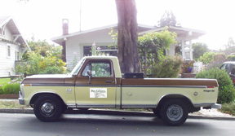


Slide 59
Is Your Heart
All In For This
Career?

Slide 60
A Woman…
A Private Forensic Science Laboratory…
A Journey

